Slide 1
Hydrogen projects outlook
Deep dive in the IEA Hydrogen Production Projects Database
Christian Dahl Winther
January 2024

Slide 2
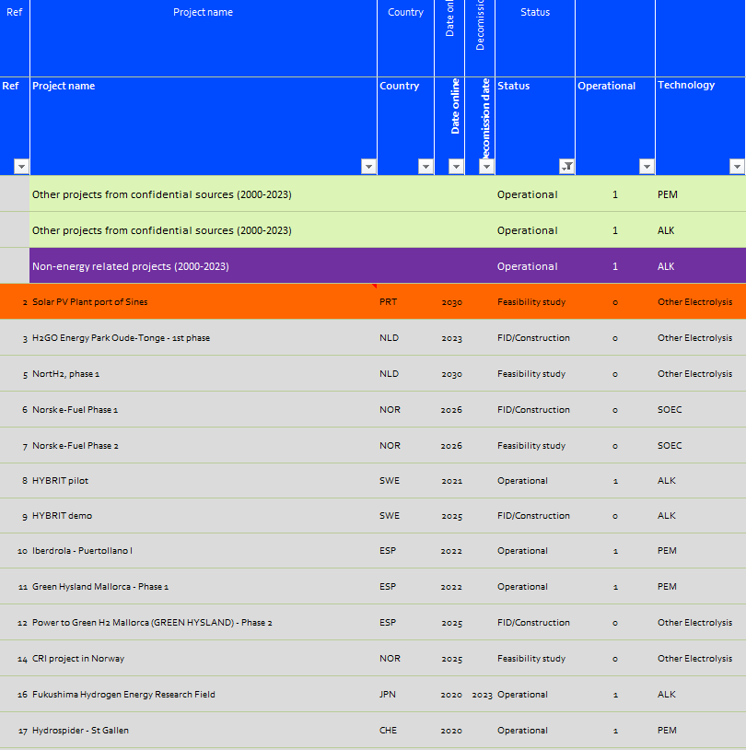
About the Hydrogen Projects Outlook
This outlook provides a status update on the global pipeline of hydrogen projects. The information is extracted from the IEA’s 'Hydrogen Production Projects Database' and presented in a series of illustrative graphs.
We believe that the IEA maintains the most comprehensive overview of the global project pipeline. It is updated once a year (the latest version was released in November 2023), so the data is recent at the time of writing.
The database contains almost 2000 different hydrogen projects and features various characteristics about each project, including geography, maturity, the (expected) year of first production, size, source of input, type of output, and electrolyzer technology.
Our primary focus is on projects that use electrolysis to produce green hydrogen, but we will also provide a few data points for the entire low-carbon hydrogen industry.
The calculations in this outlook are based on projects in the database that have achieved a certain degree of maturity in their development, understood as projects in the 'Feasibility study,' 'FID/Construction,' or 'Operational' stages. Projects in the ‘Concept phase' are excluded from the analysis, as they are considered more uncertain.
IEA’s Hydrogen Production Projects Database is available through this link: IEA Hydrogen Production Projects Database

Slide 3
Timing of new electrolyzer capacity (accumulated)
Timing of new electrolyzer capacity
To date, globally, less than 2 GW of electrolyzer capacity has been installed. By 2024, this figure is expected to increase to 13 GW, further rising to 54 GW in 2025.
For comparison, current installed power generation capacity globally is close to 10.000 GW.
According to the IEA, by 2030, approximately 180 GW of electrolyzer capacity is expected to be operational. An additional 60 GW of capacity may be added to this total, as these projects have advanced past the concept phase, but there is no indication of their first operational year.
To achieve the IEA’s Net Zero Emissions Scenarios, an estimated 590 GW of electrolyzer capacity is needed by 2030 (Hydrogen – Analysis - IEA). The current pipeline of more mature projects covers only 30-40% of this requirement.
Note: The database contains projects of around 60 GW which are indicated as having matured past the concept phase into the feasibility study phase, but without any indication of first operational year. These project are not included in the figure.
Source: IEA Hydrogen Production Projects Database, 2023.

Slide 4
Timing of new electrolyzer capacity
Timing of new electrolyzer capacity
2024 is set to become a big year. More than 10 GW expected online including major projects in Australia, Canada and Argentina.
From 2025, the annual inflow of new electrolyzer capacity is expected in the range of 20-40 GW, although there seems to be a tendency towards less new capacity announced for years immediately before and after 2030.
The pipeline of new projects after 2030 is somewhat thinner, which is naturally since this is further into the future. Many of these projects are naturally also at more of a ‘concept phase’.
In terms of average project size, there is a tendency for later projects to be bigger than earlier projects. The average project size during the period 2025-2027 is around 250 MW increasing to 650 MW during the period 2028-30.
Source: IEA Hydrogen Production Projects Database, 2023.

Slide 5
Deep dive: Timing of new electrolyzer capacity in Denmark (accumulated)
Timing of new electrolyzer capacity in Denmark
The figure illustrates the accumulated electrolyzer capacity in Denmark. It indicates that 2025 is expected to be a year of significant inflow of new capacity, reaching approximately 2 GW.
For comparison, total Danish wind- and solar capacity currently stands at around 15 GW.
Considering the historical speed of deployment, this projection seems somewhat optimistic, even with the IEA’s database being updated as recently as October 2023.
Top 5 gigawatt-sized projects in Denmark
Project name | Status | Year | Capacity (GW)
H2 Energy Europe Esbjerg green hydrogen | Feasibility study | 2025 | 1
Høst - Esbjerg green ammonia plant | Construction | 2026 | 1
Hydrogen Island | Concept | 2030 | 10,5
GreenGo Tarm plant | Concept | 2030 | 2
Ørsted - Skovgaard Energy project in western Denmark | Concept | N/A | 2,9
Note: We report the IEA’s database as is, without making any changes to the data based on our knowledge of specific projects. For example, CIP currently expects Høst to reach FID in 2025 and commence operations in 2028/29.
Source: IEA Hydrogen Production Projects Database, 2023.

Slide 6
Project maturity
59% of projects are currently in the ‘Feasibility study’ phase. Projects in the Feasibility study phase account for 93% of all announced capacity (209 GW).
18% of projects have progressed into the ‘FID/construction’ phase. Those projects account for 7% of all announced capacity (15 GW).
At present, 23% of projects are operational, yet these projects only constitute 0,5% of all announced capacity (1 GW). More than half of the operational capacity is situated in China.
(7%)
(0%)
(23%)
(18%)
(59%)
(93%)
Note: Figures exclude projects in the concept phase and where project maturity status is unknown.
Source: IEA Hydrogen Production Projects Database, 2023.

Slide 7
Geographical distribution of electrolysis project pipeline
New electrolyzer capacity by country
The graph illustrates the geographical distribution of the top 10 countries in terms of hydrogen electrolysis production capacity, with the inclusion of Sweden, France, and Denmark for reference.
Australia, Mauritania, and Chile emerge as the top three countries in terms of electrolyzer capacity.
The production capacities are categorized based on their final products. Notably, projects in countries aiming for large-scale exports focus on easily transportable chemicals, such as ammonia. This includes Australia, Mauritania, Chile, Kazakhstan, and Oman.
In contrast, projects in Europe predominantly target hydrogen, emphasizing its transportability through a regional pipeline system. It's worth noting that the pipelines for Mauritania and Kazakhstan consist of just three and one project, respectively, introducing a degree of uncertainty.
All projects depicted in the figure have progressed beyond the 'concept phase’.
Source: IEA Hydrogen Production Projects Database, 2023.

Slide 8
Geographical distribution of electrolysis project pipeline – including concept phase
New electrolyzer capacity by country
This graph highlights the same countries as the previous slide, focusing specifically on electrolyzer projects in the more mature pipeline. Here, however, we want to include projects in the ‘Concept phase’ for reference.
When projects in the concept phase are added, the aggregated project size experiences a significant increase in many jurisdictions. Specifically:
  Australia's pipeline grows from 52 GW to 129 GW.
  Chile sees an expansion from 23 GW to 64 GW.
  Mauritania's capacity increases from 28 GW to 58 GW.
  Denmark's capacity rises from 4 GW to 20 GW.
Source: IEA Hydrogen Production Projects Database, 2023.

Slide 9
Geographical distribution of hydrogen pipeline (all production types)
New hydrogen production by country
This graph illustrates the geographical distribution of the largest countries in terms of hydrogen production capacity.
It encompasses projects utilizing electrolysis (green hydrogen), natural gas (blue hydrogen), and other inputs for hydrogen production.
Australia and Mauritania persist among the top three countries. However, when considering hydrogen production involving fossil fuels and Carbon Capture, Utilization, and Storage (CCUS), the USA, the Netherlands, and the UK ascend the list.
Note: Project sizes are measured in kt H2/y which allows us to compare projects across hydrogen production technologies. All projects gave progressed beyond the ’concept phase’.
Source: IEA Hydrogen Production Projects Database, 2023.

Slide 10
Alignment between project pipeline and political targets
Alignment between project pipeline and political targets for 2030
A few countries have established targets for the level of electrolyzer capacity to be installed by 2030 through their national hydrogen strategies.
As of 2023, there is virtually no electrolyzer capacity installed anywhere, which means there is a considerable distance to cover to achieve the 2030 targets.
Upon comparing the announced project pipeline for 2030, it appears that countries with national hydrogen strategies are likely to meet their political targets, assuming the pipeline is successfully realized.
Note: Compared to previous slides Australia, USA, Mauritania, Kazakhstan, Oman, and China has been excluded as they do not have any politically decided targets yet. The figure only includes projects that have progressed past the ‘concept phase’.
Sources: BNEF (electrolyzer targets), IEA Hydrogen Production Projects Database, 2023 (capacities).

Slide 11
Type of production technology chosen among all projects
Choice of production technology across projects
Of all the projects in the database, 73% (based on production capacity) plan to produce 'green' hydrogen through electrolysis.
Additionally, 20% of all projects aim to produce 'blue' hydrogen through a chemical reforming process, where natural gas is split into hydrogen and carbon monoxide. The associated carbon content of the natural gas is either stored underground or utilized for other purposes, a practice known as Carbon Capture, Utilization, and Storage (CCUS).
Note: Percentages are calculated based on kilotons of hydrogen produced per year (ktH2/y). The data excludes projects categorized as "Other Electrolysis" and "Unknown.“
Source: IEA Hydrogen Production Projects Database, 2023.

Slide 12
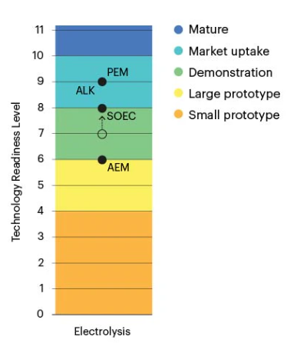
Type of technology chosen by electrolysis projects
Choice of electrolysis technology
Polymer Electrolyte Membrane Electrolysis (PEM) is the most widely used technology accounting for 57% planned project capacity.
Alkaline (ALK) follows at 41%. Both ALK and PEM are considered mature at TRL 9 according to the IEA and are commercially available.
Solid Oxide Electrolysis Cell (SOEC) represents 2%. SOEC is not yet fully mature at TRL 8 but is starting to see market uptake.
COWI has provided a concise description of the various technologies: Electrolysis: The Backbone of the Green Transition (cowi.com).
Note: Percentages are based on MW capacity. We exclude observations where the technology choice is 'Other Electrolysis' or 'Unknown.’
Source: IEA Hydrogen Production Projects Database, 2023.
Note: IEA employs an 11-step TRL scale.
Source: IEA homepage.

Slide 13
Choice of input for electrolysis
Choice of electricity source for the electrolysis
The majority of energy for electrolytic hydrogen projects is anticipated to come from dedicated renewables, constituting 88%.
Meanwhile, 8% of projects plan to source electricity from the grid to some extent, rather than having pre-contracted with a specific wind farm or solar park.
In Europe, purchasing electricity in the wholesale market (understood in IEA's terminology as sourcing electricity from the grid) is particularly relevant in countries with a high and consistent share of renewables in the power mix. Examples include Sweden, Norway, France, and possibly Denmark. These countries are likely to achieve a 90% renewable share within the bidding zone, as stipulated by the Renewable fuels of non-biological origin (RFNBO) rules, both presently and in the near future.
Among projects souring electricity from dedicated renewables, the majority is a mix of solar and wind, comprising 51%. For many projects, this combination often makes the most sense, as it provides a stable inflow of electricity for the electrolysis process.
19% of projects aim to source electricity from wind, with 11% from onshore wind and 8% from offshore wind. Additionally, 13% of projects exclusively source electricity from solar PV.
Source: IEA Hydrogen Production Projects Database, 2023.

Slide 14
Choice of input for electrolysis in different geographies
Input for electrolysis in different geographies
Examining the input sources chosen by projects in different countries reveals, similar to the previous slide, that most projects aim for a mix of wind and solar energy for electrolysis.
Projects exclusively focusing on solar PV are primarily located in Australia and Spain.
Those concentrating on wind energy exclusively are primarily found in Chile, the Netherlands, Germany, and the US. Projects in Denmark typically aim for a mix of both.
Notably, projects in France emphasize sourcing electricity from the grid, aligning with France's significant share of nuclear power, which is also considered conducive to green hydrogen following the RFNBO rules.
Source: IEA Hydrogen Production Projects Database, 2023.

Slide 15
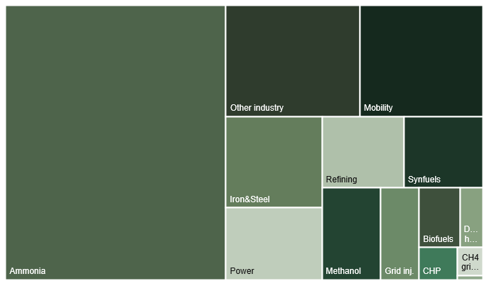
Expected end-use applications of output
Expected end-use
46% of all electrolyzer capacity is expected to produce hydrogen for ammonia production.
The low 4% expectation for methanol production is a bit surprising, given the anticipation that the shipping industry would likely use a significant amount of fuel.
The remaining 50% of the output is used as hydrogen directly, with various applications including Mobility (10%), Iron & Steel (7%), and Refining (4%).
There is limited use for hydrogen in power production (5%) and for grid injection (3%), reflecting that these are normally not considered very competitive uses of hydrogen.
Note: Electrolysis projects only. The shares are based on electrolyzer capacity.
Source: IEA Hydrogen Production Projects Database, 2023.

Slide 16
Contact:
Christian Dahl Winther
Denmark’s Export- and Investment Fund
Associate Director, Head of Energy Economics cdw@eifo.dk

